Slide 1


Song Recommendation Engine

Slide 2
Business Problem:
Developing an innovative music recommendation system that effectively predicts and suggests personalized music playlists to users based on their individual preferences, listening history, mood, and contextual factors, thereby enhancing user engagement, satisfaction, and retention within our music streaming platform.
Objective:
The objective of this project is to build a feature of recommendation system to support a music app. As the first phase we need to develop the proof of concept to make the client understand how effective the feature could be.
POC for Recommendation Engine for a Yoga, Relaxation or Devotional Songs Music application targeted for Indian users

Slide 3
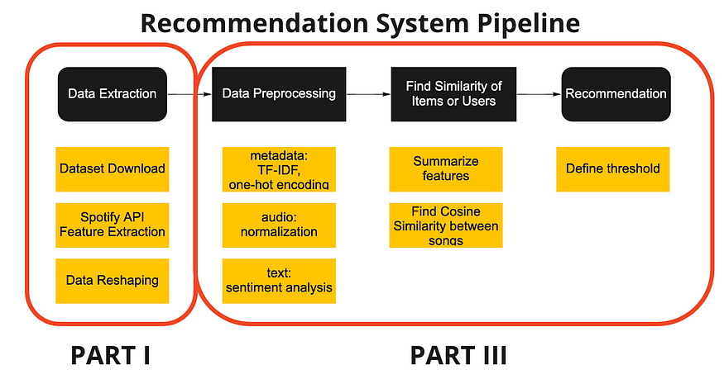
Project Architecture / Project Flow

Slide 4
TOOLS:
PANDAS
NUMPY
MATPLOTLIB
SEABORN
PCA
CLUSTERING
PICKLE

Slide 5
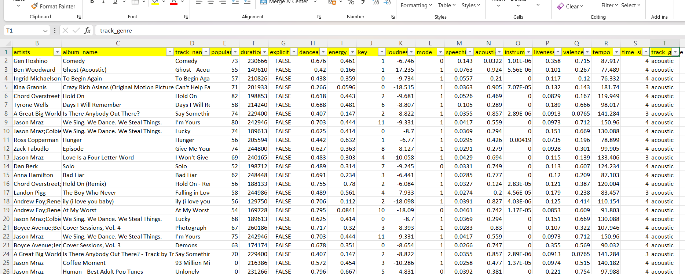
DataSet

Slide 6
Exploratory Data Analysis (EDA)
Exploratory Data Analysis (EDA) refers to the method of studying and exploring record sets to apprehend their predominant traits, discover patterns, locate outliers, and identify relationships between variables. EDA is normally carried out as a preliminary step before undertaking extra formal statistical analyses or modeling.
The Foremost Goals of EDA
1. Data Cleaning
2. Descriptive Statistics
3. Correlation and Relationships
4. Data Visualization
5. Outlier Analysis and Handling

Slide 7
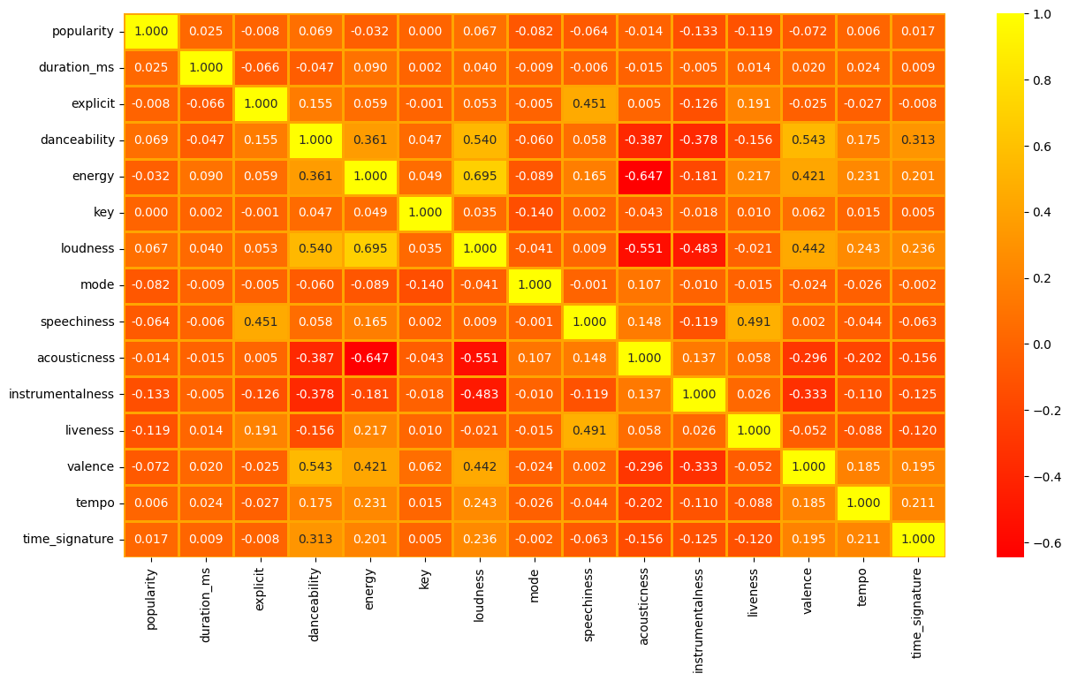
Visualization
HeatMap

Slide 8
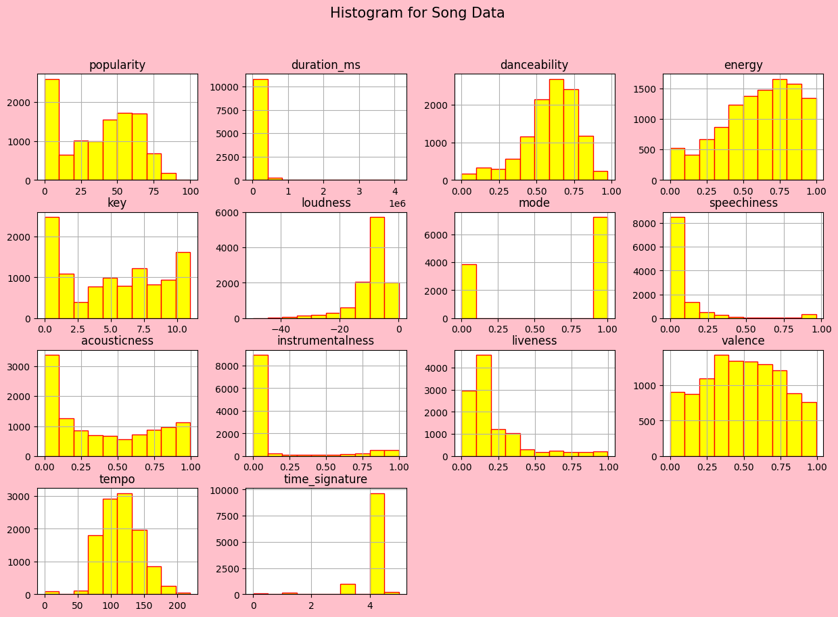
Histogram

Slide 9
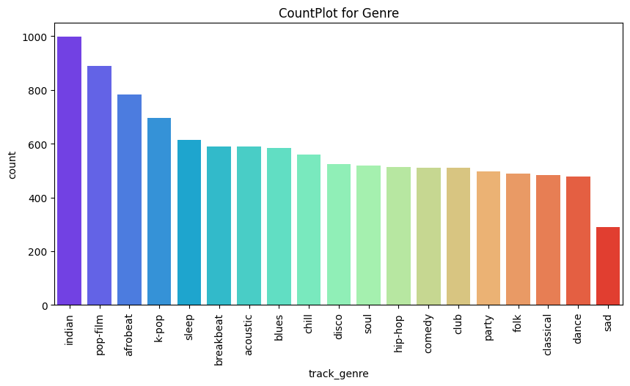
CountPlot for Genre Feature

Slide 10
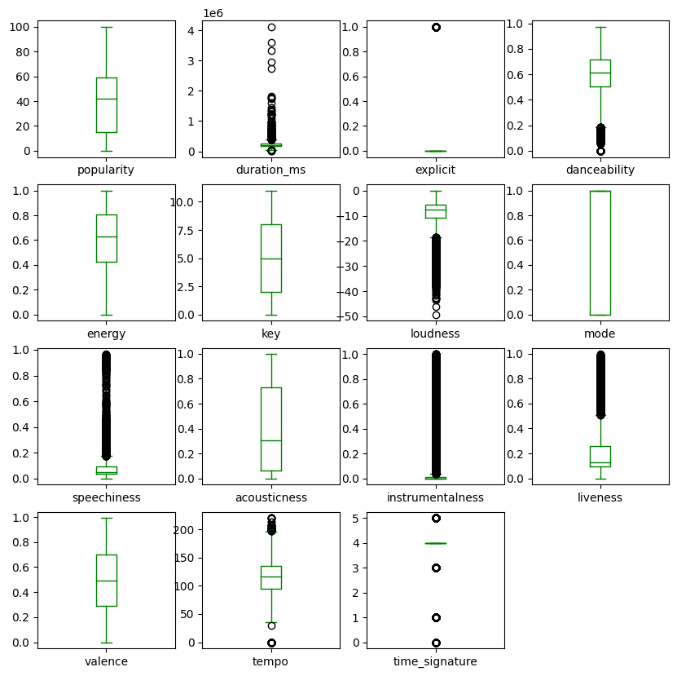
BoxPlot

Slide 11
Feature Engineering
Feature engineering is a machine learning technique that leverages data to create new variables that aren't in the training set. It can produce new features for both supervised and unsupervised learning, with the goal of simplifying and speeding up data transformations while also enhancing model accuracy.
Label Encoding
Feature Scaling
PCA
KMEANS Clustering

Slide 12
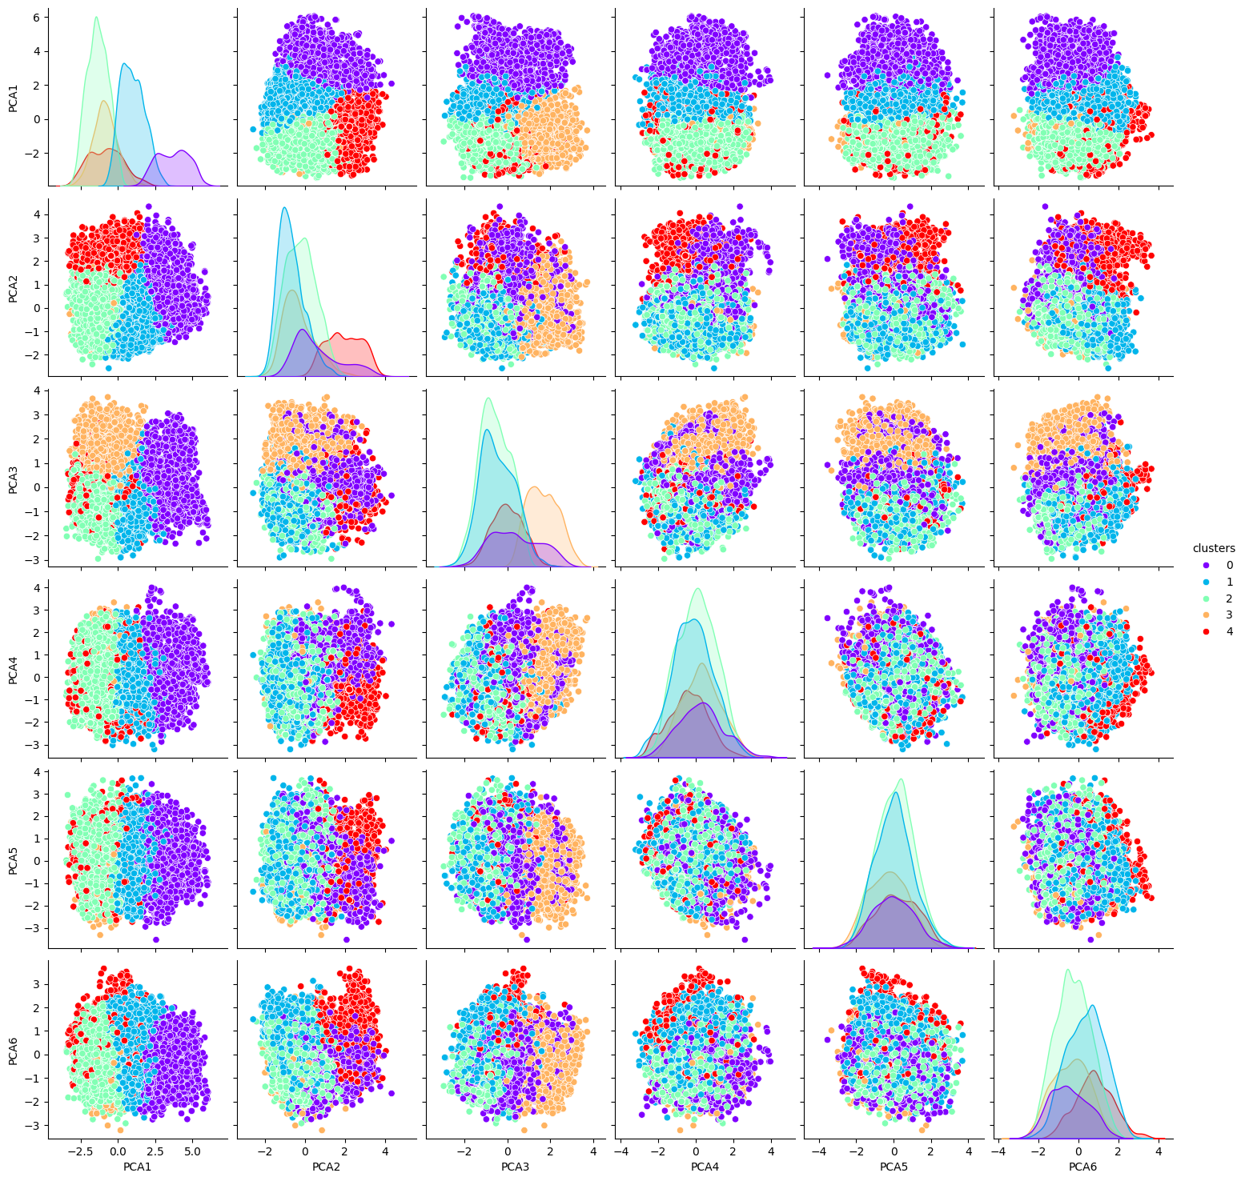
KMEANS

Slide 13
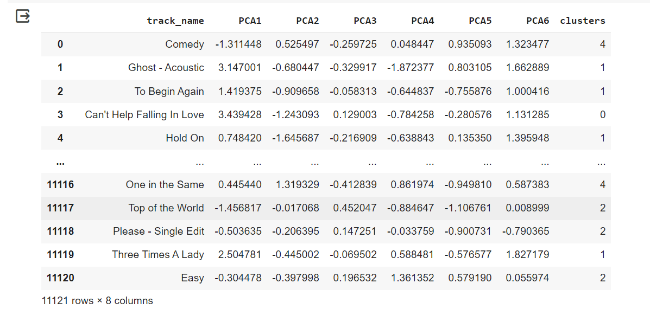

Slide 14
Model Building
Cosine similarity
Cosine similarity is a metric based on the cosine distance between two objects and can be used in recommendation systems such as movie and book recommenders. In this article, we will learn what it is and how it can be used to make recommendations by identifying similar items

Slide 15
Model Deployment
Deployment using Streamlit
Streamlit is a free and open-source framework to rapidly build and share beautiful machine learning and data science web apps. It is a Python-based library specifically designed for machine learning engineers. Streamlit allows you to create a stunning-looking application with only a few lines of code.

Slide 16
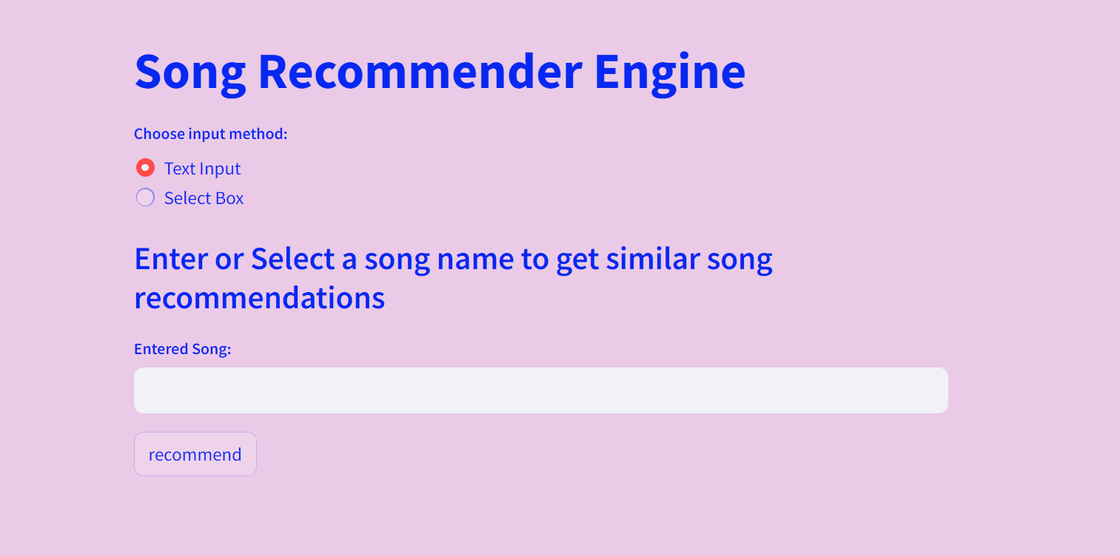
Final Web Page

Slide 17
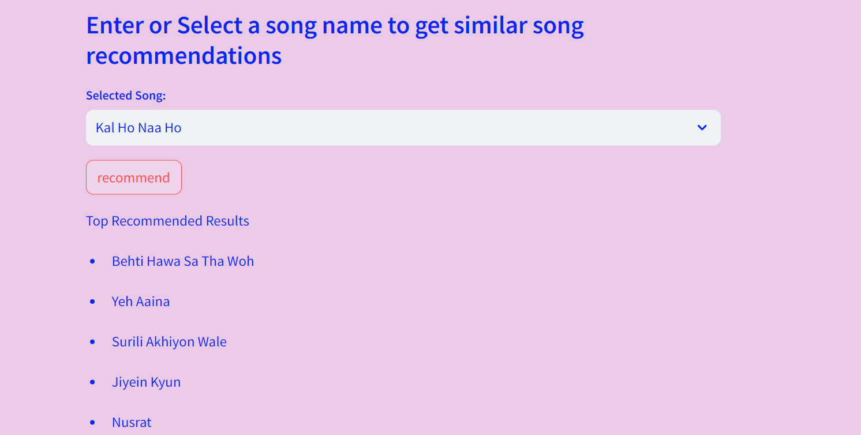

Slide 18
Challenges faced?
High Dimensional Data: Song data often contains a high number of features, such as audio features (tempo, energy, danceability , liveness) and metadata (aritists, genre, duration)
Scalability: As the song database grows, clustering algorithm must scale to handle the increasing volume of data efficiently.
Irrelevant Data: When we collect the data from various sources we may face the problem of unbalanced, missing values, duplicates, outliers and errors.
How did you overcome?
Data Preprocessing : To handle the inconsistencies and errors in the song data. This might involves standardizing metadata formats, imputing missing values, removing duplicates, and ensuring data quality and consistency across sources.
Feature Engineering and Selection: Selecting or engineering relevant features from the song data is crucial for effective clustering.
Model Building: Performing different model building in order to get good accuracy

Slide 19


